Slide 1
International Study of Comparative Health Effectiveness with Medical and Invasive Approaches Primary Report of Quality of Life Outcomes
EMBARGOED for 2pm ET 11-16-19
Funded by National Heart, Lung, and Blood Institute
John A. Spertus, MD, MPH
Saint Luke’s Mid America Heart Institute/UMKC
On behalf of the ISCHEMIA Research Group
*Abbreviated Title
Notes:
Based on DM SCT presentation

Slide 2
ISCHEMIA QoL Research Question
In a stable patient with at least moderate ischemia, does an invasive strategy…
improve patients’ health status (their symptoms, function and quality of life)?

Slide 3
Study Design
Stable Patient
Moderate or severe ischemia
(determined by site; read by core lab)
INVASIVE Strategy + OMT
…
R
1.5m
3m
6m
12m
18m
24m
30m
36m
CONSERVATIVE OMT alone (Cath if needed)
Brief QoL Assessments
Brief QoL Assessment
Brief QoL Assessment:
Seattle Angina Questionnaire – 7
Angina Frequency
Quality of Life
Physical Limitations
Completion Rates
**
Con: 91%
Inv: 88%
88%
89%
94%
93%
93%
92%
92%
92%
90%
91%
91%
90%
89%
88%
**
SAQ Summary Score*
*Primary QoL Outcome
**Secondary QoL Outcome

Slide 4
Interpreting and Stratifying SAQ Scores
SAQ Angina Frequency Scale:
Over the past 4 weeks, how often have you had angina?
$≥$4X/day
1-3X/day
$≤$3X/week
1-2X/week
<1X/week
Not at All
0
20
40
60
80
100
Daily
Weekly
Monthly
None
Daily/Weekly

Slide 5
Statistical Methods
Simple descriptive statistics of observed mean scores
Mixed-effect proportional odds models for all QOL scales
Treatment effect = Odds ratio for QOL ≥ X, at each time point
Results transformed to individual SAQ scales
Bayesian methods used for all models to directly estimate probability of treatment effect with posterior means and 95% posterior density intervals
Analyses performed for all patients and stratified by baseline angina
e.g. daily/weekly vs. several times per month vs. no angina

Slide 6
Patient Flow
5,179 Randomized
2,591 Conservative
2,588 Invasive
239 improper form completion
242 improper form completion
2,352 Eligible for
QOL Analyses
2,346 Eligible for
QOL Analyses
17 no baseline assessment
13 no follow-up assessments
29 no baseline assessment
22 no follow-up assessments
2,322 Included in Analyses of
Treatment Effect
2,295 Included in Analyses of Treatment Effect

Slide 7
Baseline Health Status
Scale | Invasive | Conservative
SAQ Summary Score | 73.3$±$19 | 74.8$±$19
SAQ Quality of Life Score | 60.9$±$27 | 62.7$±$26
SAQ Angina Frequency Score | 80.8$±$20 | 82.1$±$19
Daily/Weekly Angina | 21.6% | 19.0%
Several Times per Month | 44.1% | 44.5%
No Angina | 34.3% | 36.6%

Slide 8
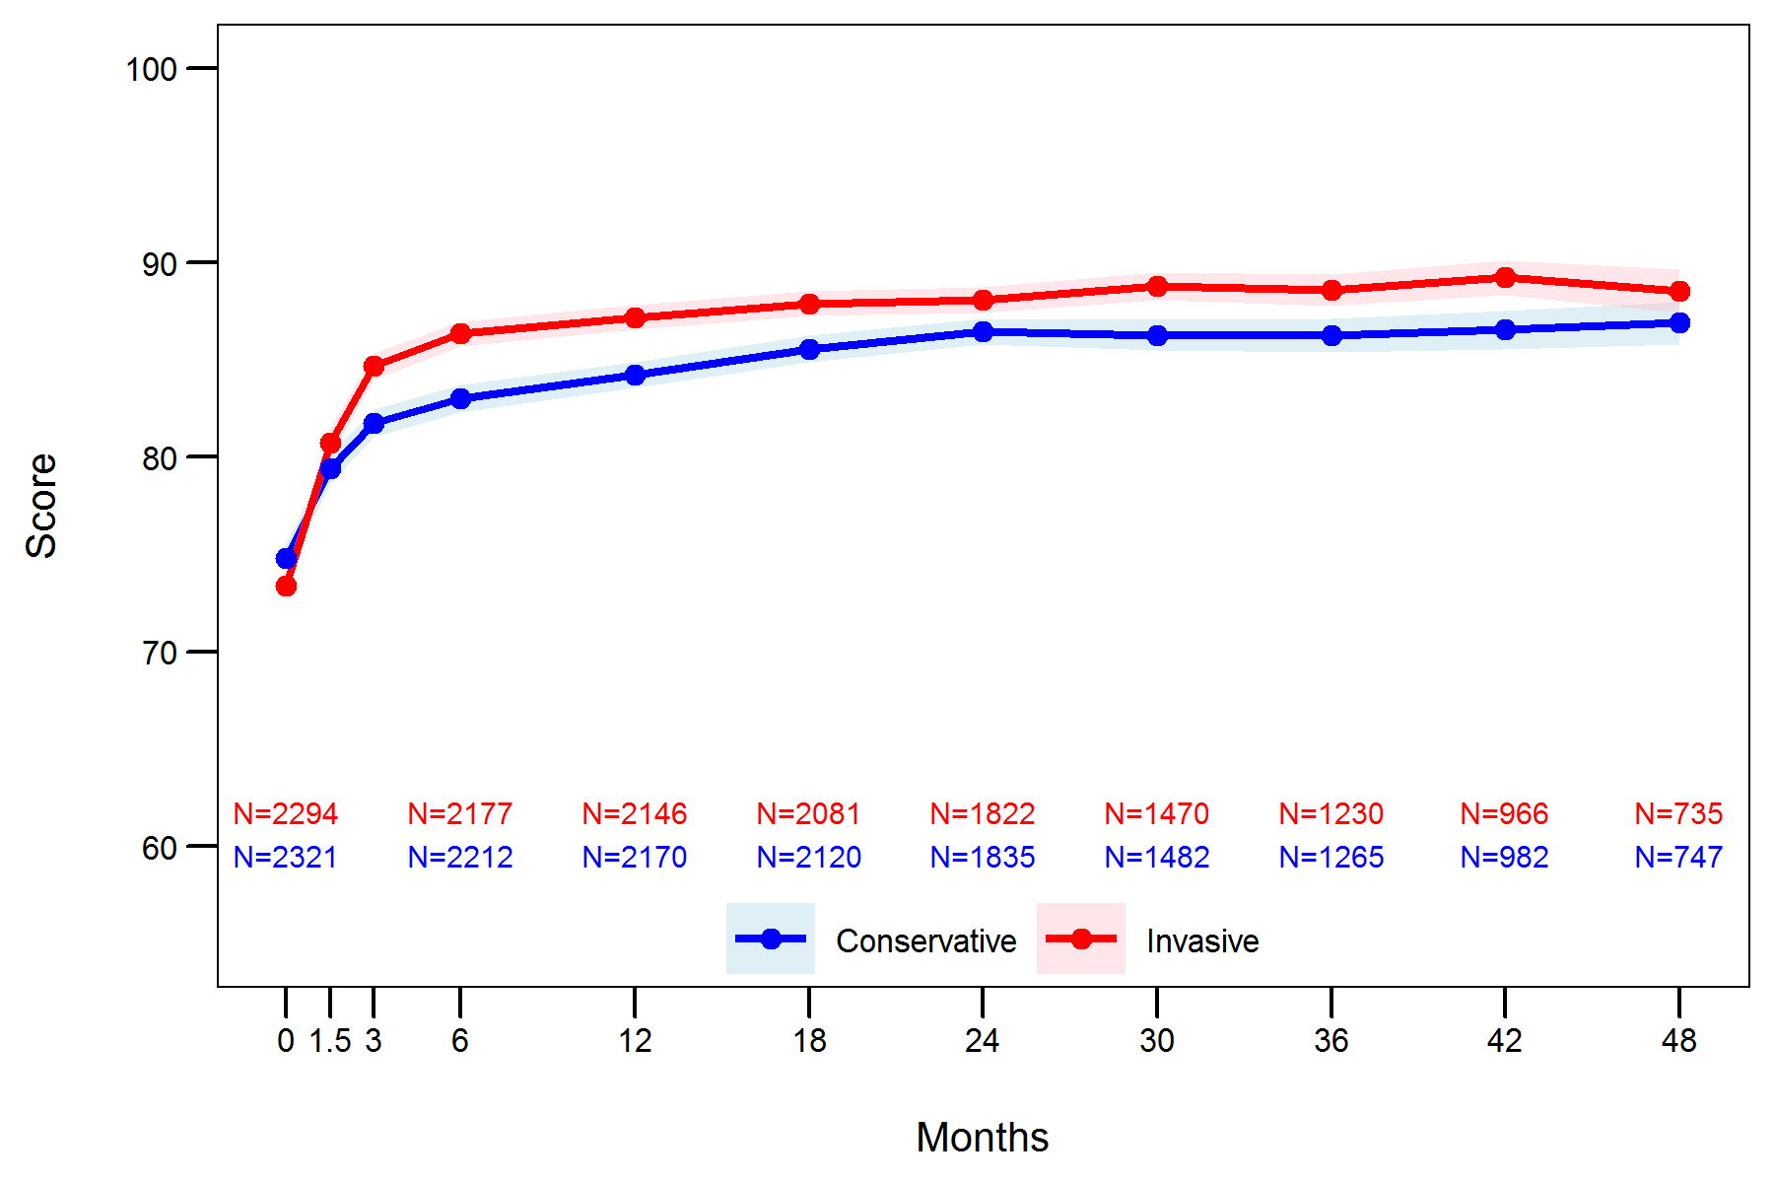
Description of Observed Data
SAQ Summary Score

Slide 9
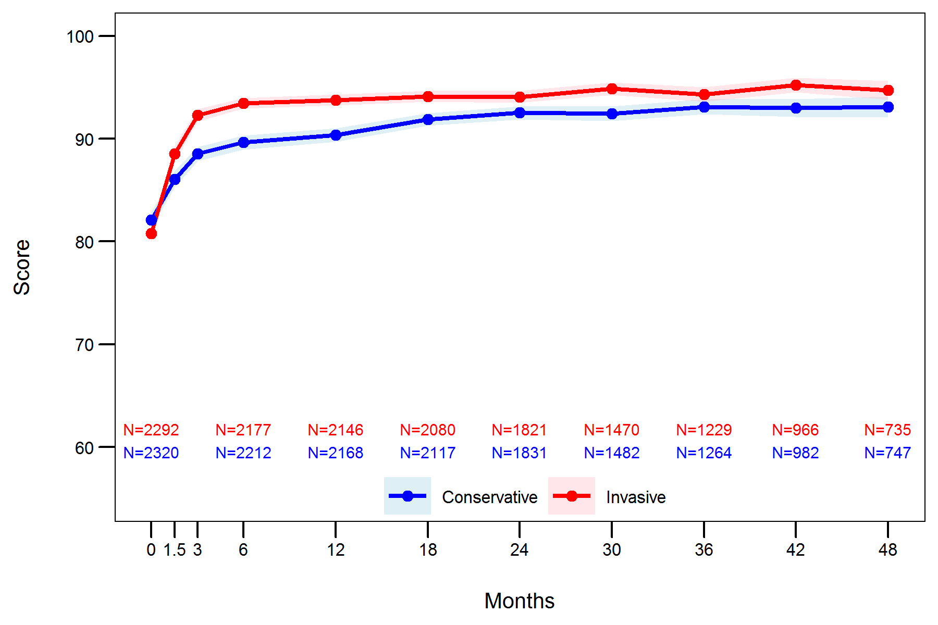
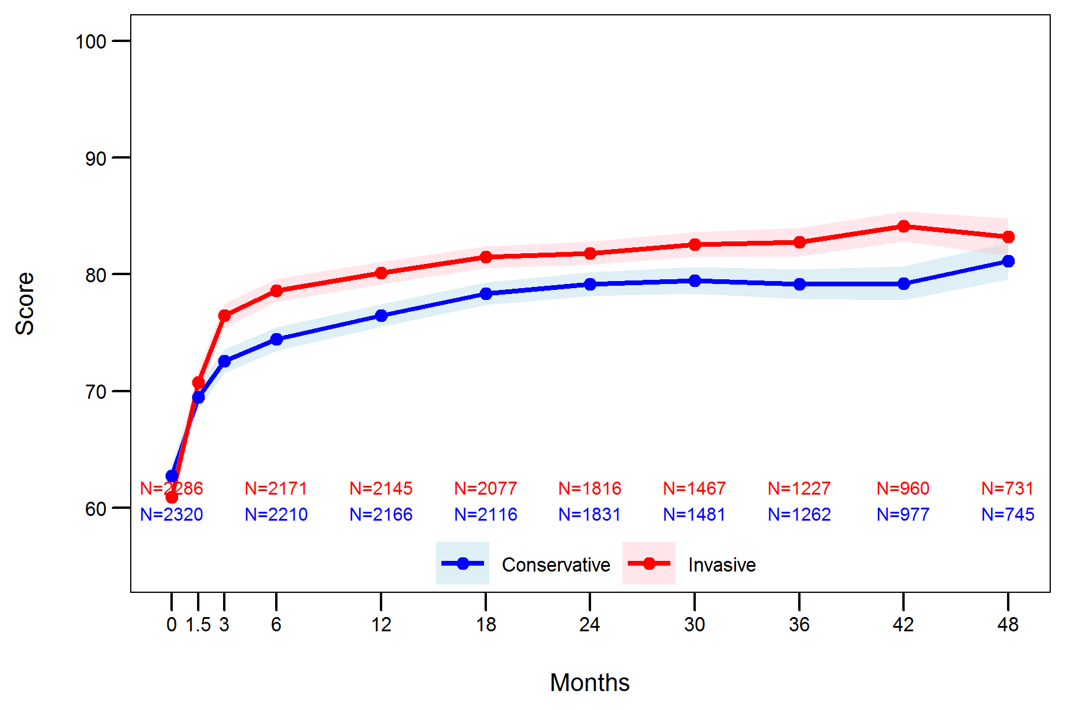
Description of Observed Data
SAQ Angina Frequency
SAQ Quality of Life

Slide 10
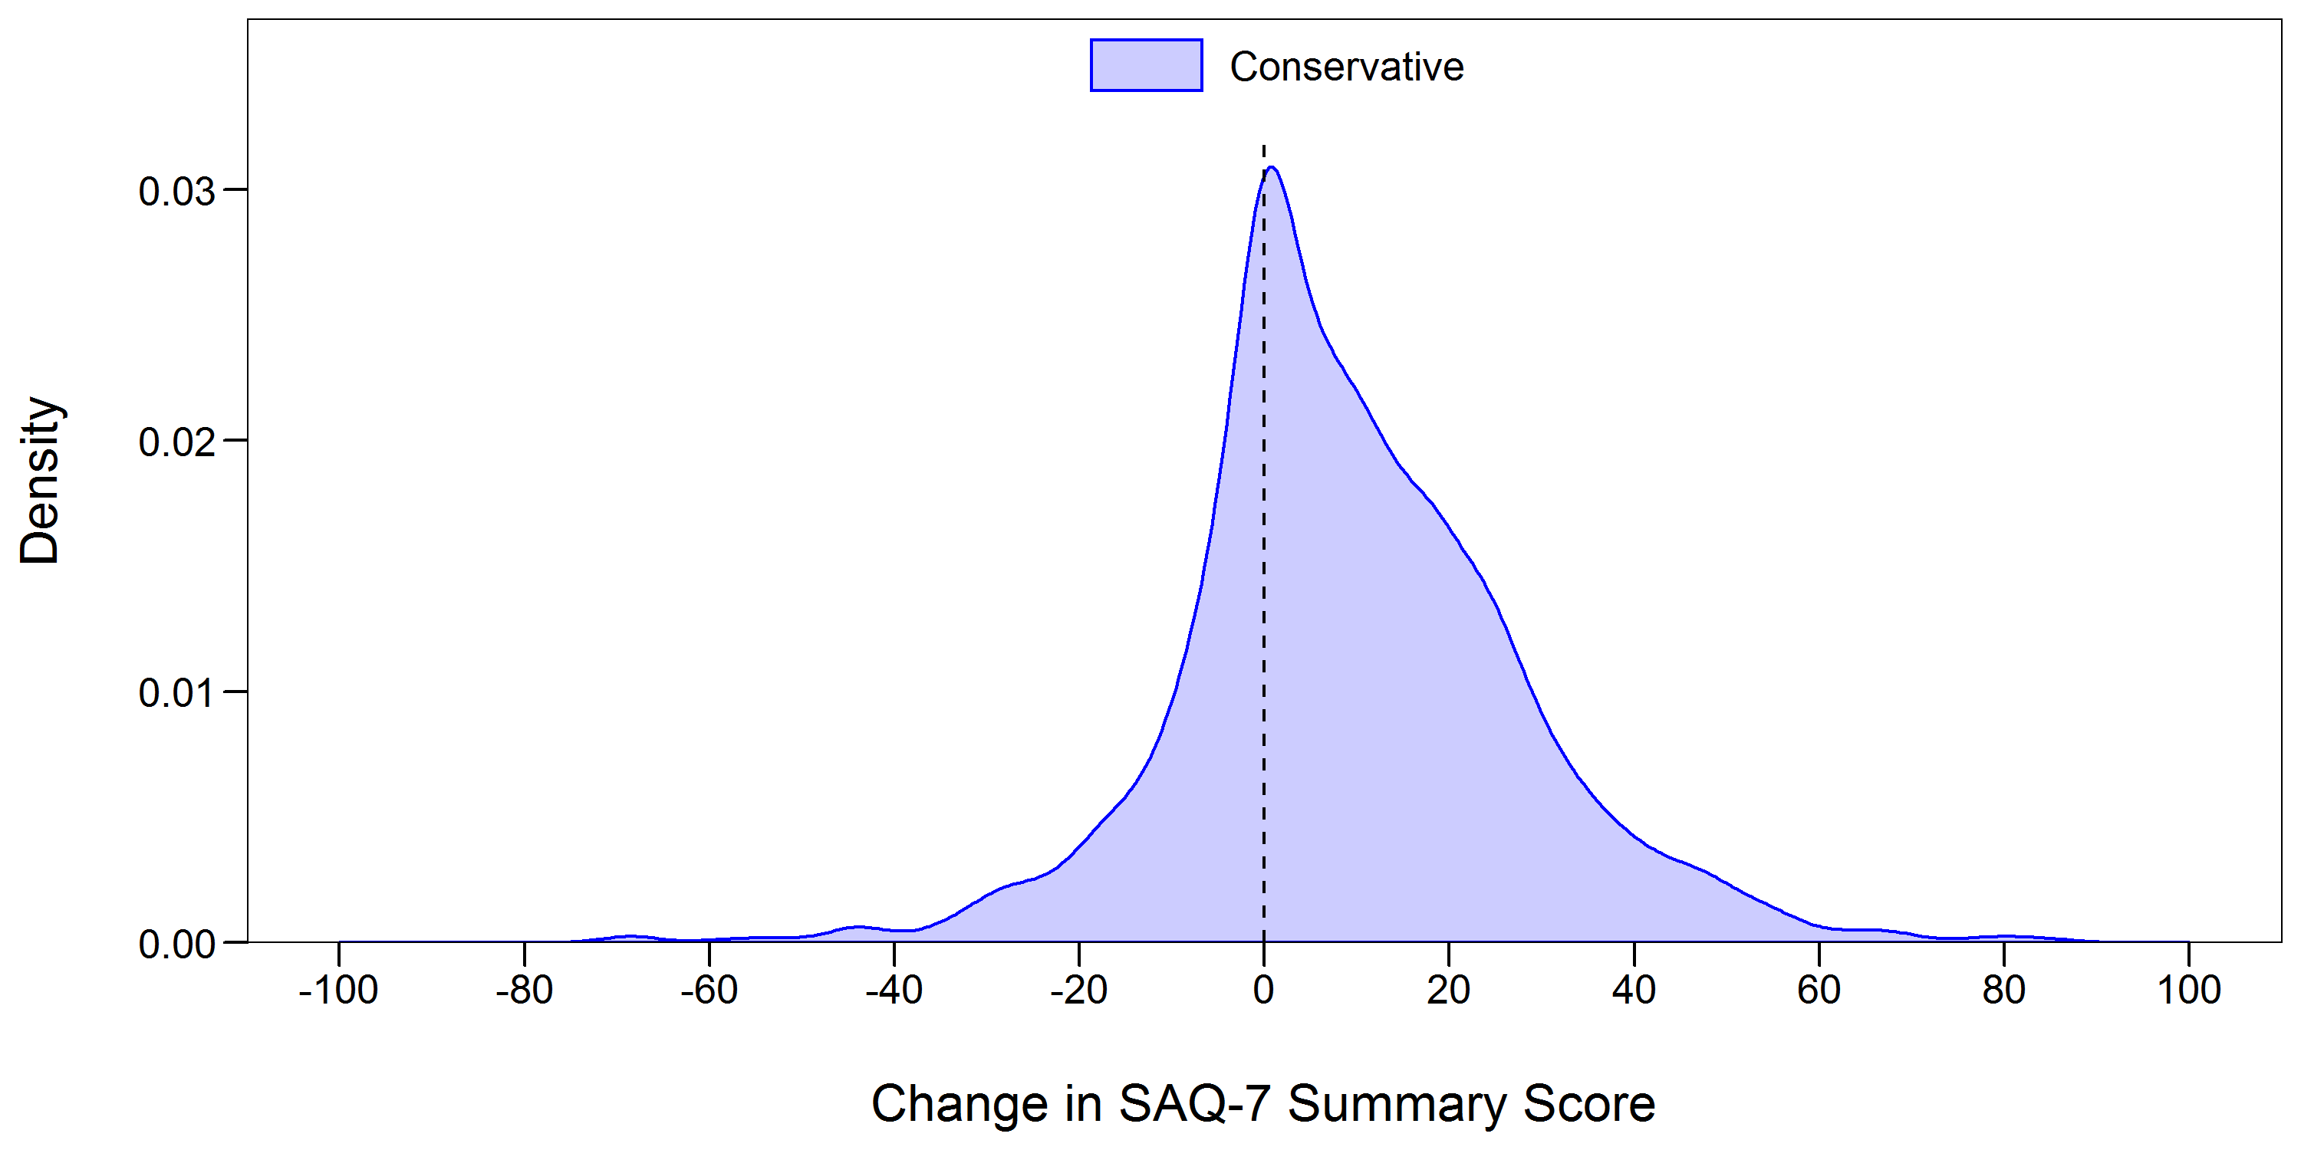
Improvement in SAQ Summary Score at 12 Months

Slide 11
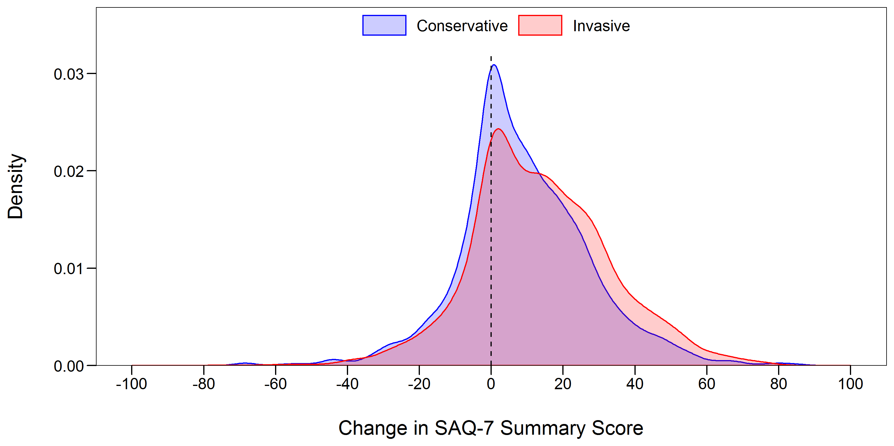
Improvement in SAQ Summary Score at 12 Months

Slide 12
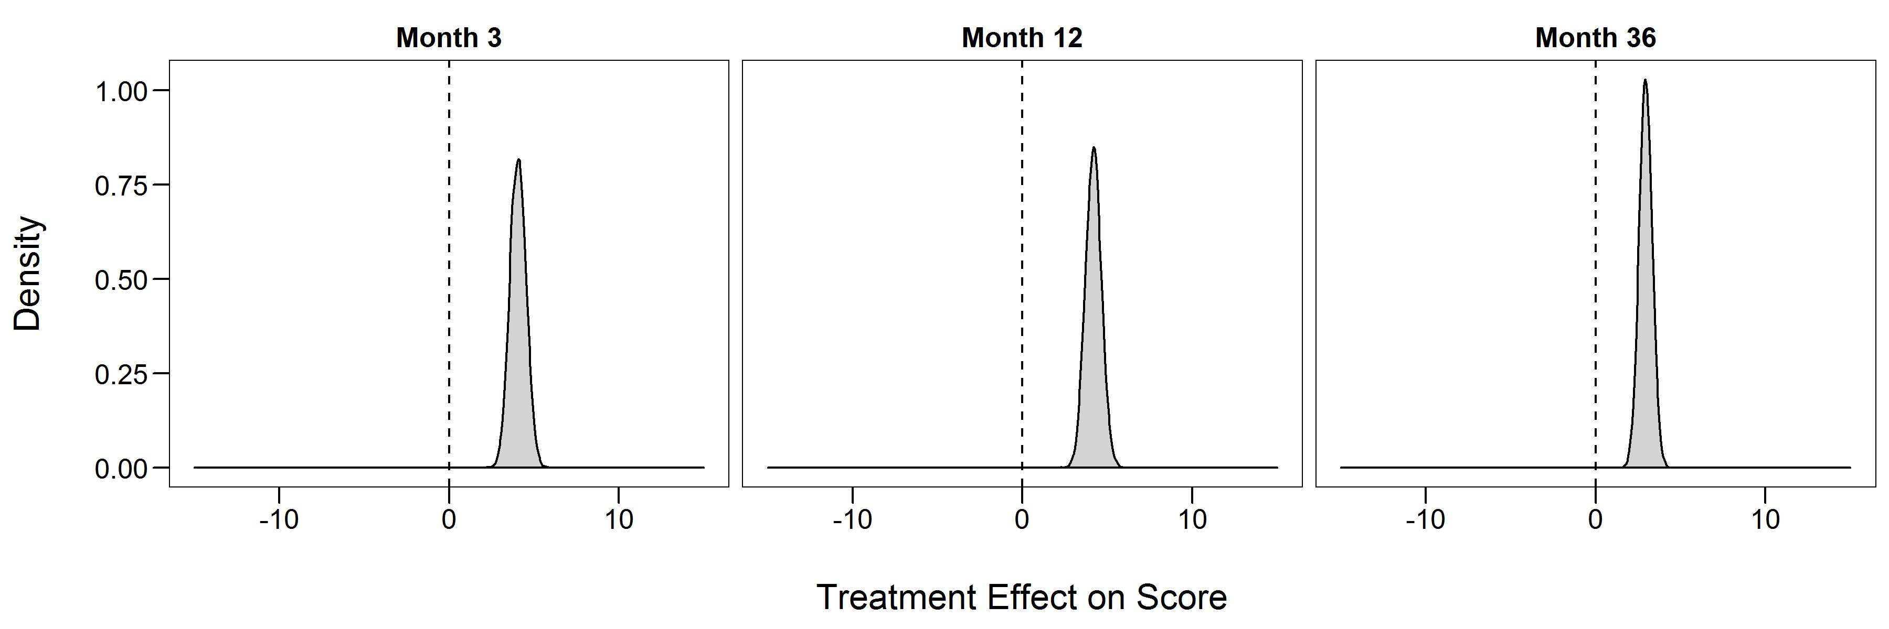
Primary Outcome: Benefit of Invasive Rx on SAQ Summary Score
Typical Patient in ISCHEMIA
Posterior Mean = 4.1 (3.2, 5.0)*
Posterior Mean = 4.2 (3.3, 5.1) *
Posterior Mean = 2.9 (2.2, 3.7)*
Favors Conservative
Favors Invasive
Favors Conservative
Favors Invasive
Favors Conservative
Favors Invasive
*95% Highest Posterior Density Interval
Notes:
Shift from ORs to actual scores

Slide 13
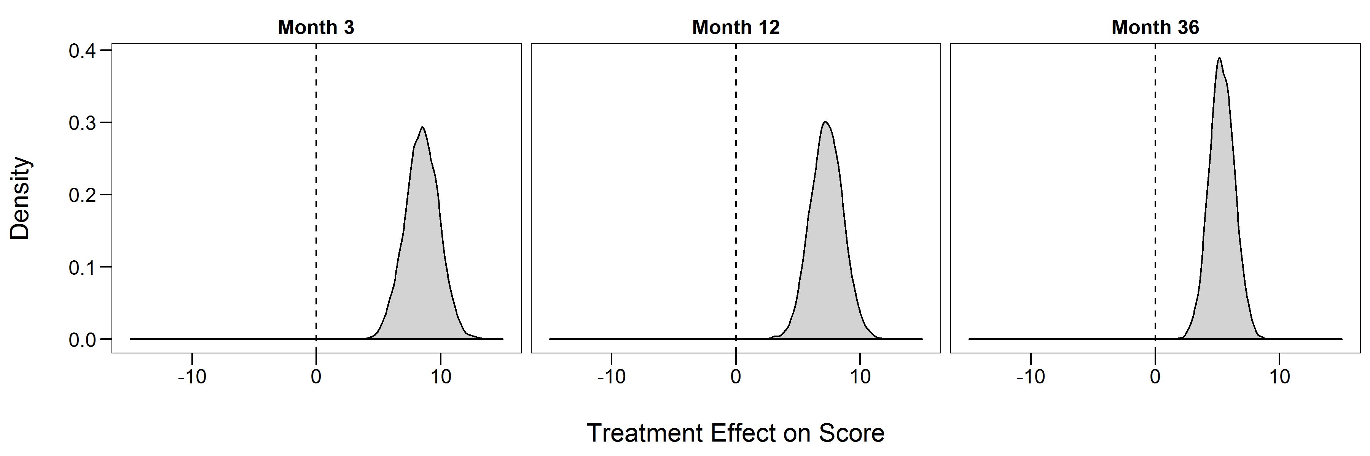
Primary Outcome: Benefit of Invasive Rx on SAQ Summary Score
Typical Patient with Daily to Weekly Angina
Posterior Mean = 8.5 (5.8, 11.1)*
Posterior Mean = 7.3 (4.8, 9.9)*
Posterior Mean = 5.3 (3.4, 7.5)*
Favors Conservative
Favors Invasive
Favors Conservative
Favors Invasive
Favors Conservative
Favors Invasive
*95% Highest Posterior Density Interval

Slide 14
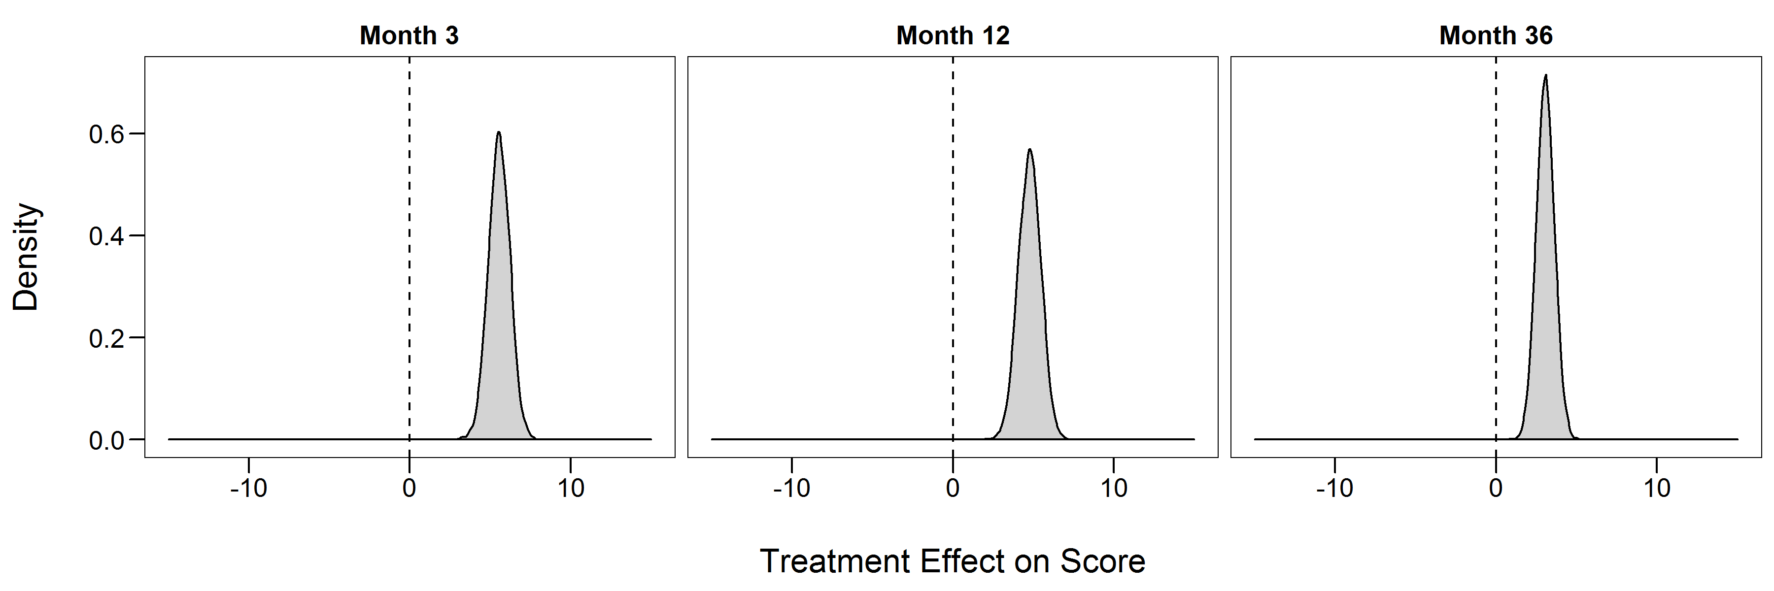
Primary Outcome: Benefit of Invasive Rx on SAQ Summary Score
Typical Patient with at least Monthly Angina
Posterior Mean = 5.5 (4.3, 6.9)*
Posterior Mean = 4.8 (3.4, 6.1)*
Posterior Mean = 3.1 (2.0, 4.2)*
Favors Conservative
Favors Invasive
Favors Conservative
Favors Invasive
Favors Conservative
Favors Invasive
*95% Highest Posterior Density Interval

Slide 15
Primary Outcome: Benefit of Invasive Rx on SAQ Summary Score
Typical Patient with No Angina
Posterior Mean = 0.1 (-1.2, 1.4)*
Posterior Mean = 1.7 (0.4, 2.9)*
Posterior Mean = 1.2 (0.2, 2.2)*
Favors Conservative
Favors Invasive
Favors Conservative
Favors Invasive
Favors Conservative
Favors Invasive
*95% Highest Posterior Density Interval

Slide 16
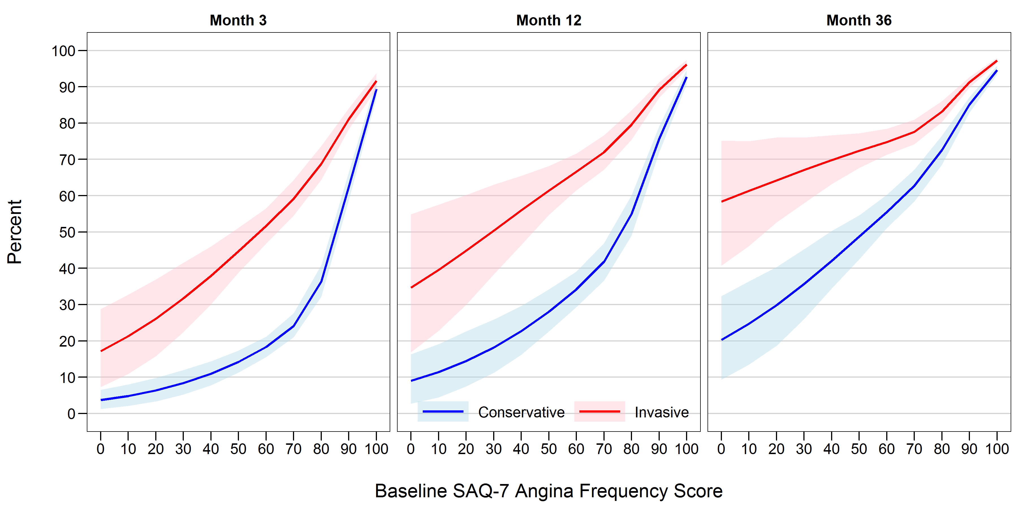
Probability of No Angina by Baseline Angina Frequency
No
Difference
45%
NNT = ~3
15%
Daily
Weekly
Monthly
None
n=8
8
67
30
172
140
509
500
850
693
1635

Slide 17
Limitations
Missing SAQ data, although small (<10%)
Skewed enrollment towards less symptomatic patients
The larger effects in more symptomatic still clearly assessable
No sham group
Nonetheless, angina-free benefits comparable with that seen in ORBITA

Slide 18
Conclusions
Patients with stable CAD and moderate to severe ischemia had significant, durable improvements in angina control and quality of life with an invasive strategy if they had angina (daily/weekly or monthly)
In patients without angina, an invasive strategy led to minimal symptom or quality of life benefits, as compared with a conservative strategy
In patients with angina, shared decision-making should occur to align treatment with patients’ goals and preferences

Slide 19
Thank you….
Quality of Life Core Lab: Philip Jones, Dan Mark, Khaula Baloch, Lisa Hatch
ISCHEMIA Trial Chair & Co-Chair: Judith Hochman, David Maron
ISCHEMIA Analytic Center and DSMB: Sean O’Brien, Frank Harrell
ISCHEMIA Site PIs and Data Coordinators
The Patients volunteering to participate in ISCHEMIA

Slide 20
Backup Slides

Slide 21
SIHD Management after ISCHEMIA
Patients with Stable CAD
Optimal Medical Therapy
None or Satisfied
PCI
Left Main Disease
Yes
No
Multi-disciplinary Heart Teams
Cath ± Revasc
Residual Symptoms?
No
Yes
Pt Discussion/Preferences for current Symptoms
CABG
Unsatisfied

Slide 22
DISCLOSURES
Dr. John A. Spertus discloses the following relationships: Co-PI for the ISCHEMIA Quality of Life and Economics trial for which, in addition to support by National Heart, Lung, and Blood Institute grant, there are in-kind donations for participating sites from Abbott Vascular; Medtronic, Inc.; St. Jude Medical, Inc.; Volcano Corporation; Arbor Pharmaceuticals, LLC; AstraZeneca Pharmaceuticals, LP; Merck Sharp & Dohme Corp.; Omron Healthcare, Inc.; and Amgen Inc.; and financial donations from Arbor Pharmaceuticals LLC and AstraZeneca Pharmaceuticals LP. Dr. Spertus owns the Copyright to the Seattle Angina Questionnaire.
Unrelated to ISCHEMIA, he serves as an advisor to Novartis, Bayer, Janssen, Amgen, AstraZeneca, United Healthcare and Merck. He also owns the copyright to the KCCQ and PAQ, has an equity interest in Health Outcomes Sciences and is on the Board of Blue Cross/Blue Shield of Kansas City
ClinicalTrials.gov registration: NCT01471522

